Slide 1

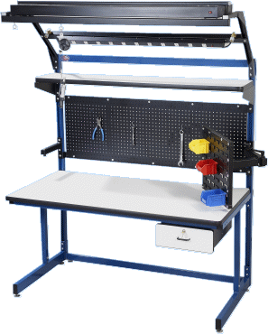


Implementation of Whole Body Scanner for
Real Time Optimization of Workstations
Faculty Advisor: Dr. Gonzalez
Course Advisor: Dr. Sarkar
Caleb Jaime
Manufacturing Engr.
Jesus G. Cavazos
Manufacturing Engr.
Estefania Gonzalez
Manufacturing Engr.

Slide 2
  Outline
Background
Problem Formulation
  Problem Definition
  Background Research
  Goals, Objectives and Constraints
  QFD
Final Design
  Concept Generation Methodology
  Final Design
Manufacturing Processes
  BoM
  Process routing and Assembly
  Final Product
  Final Product Vs. CAD Model
  Operations Manual
  Maintenance Manual
Test Results and Analysis
  Raw Data
  Data Analysis
  Tables and graph
  Videos (during Experiments)
Results and Discussions
Conclusions
Best Practices
Lessons learned
Summary
Future Recommendations
References
Acknowledgements
Prototype Demonstration

Slide 3

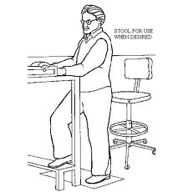
Problem Formulation
Industrial workstations generally designed for the extremes
  Ergonomic issues
    Unexpected costs
      Loss in productivity
      Increased levels of scrap
      Health claims

Slide 4
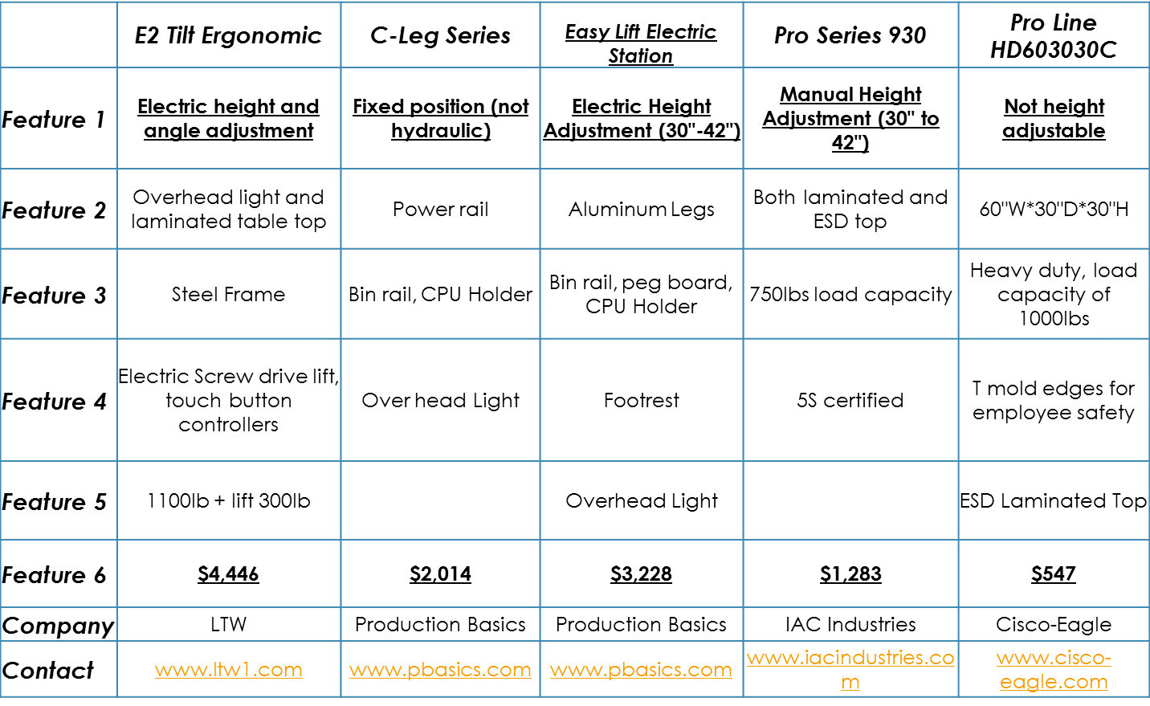
Competitive Products

Slide 5
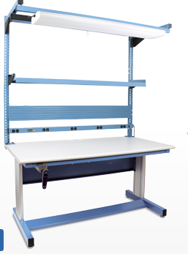
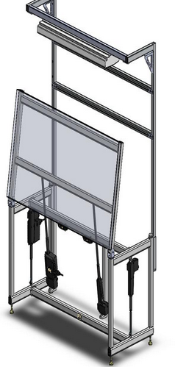
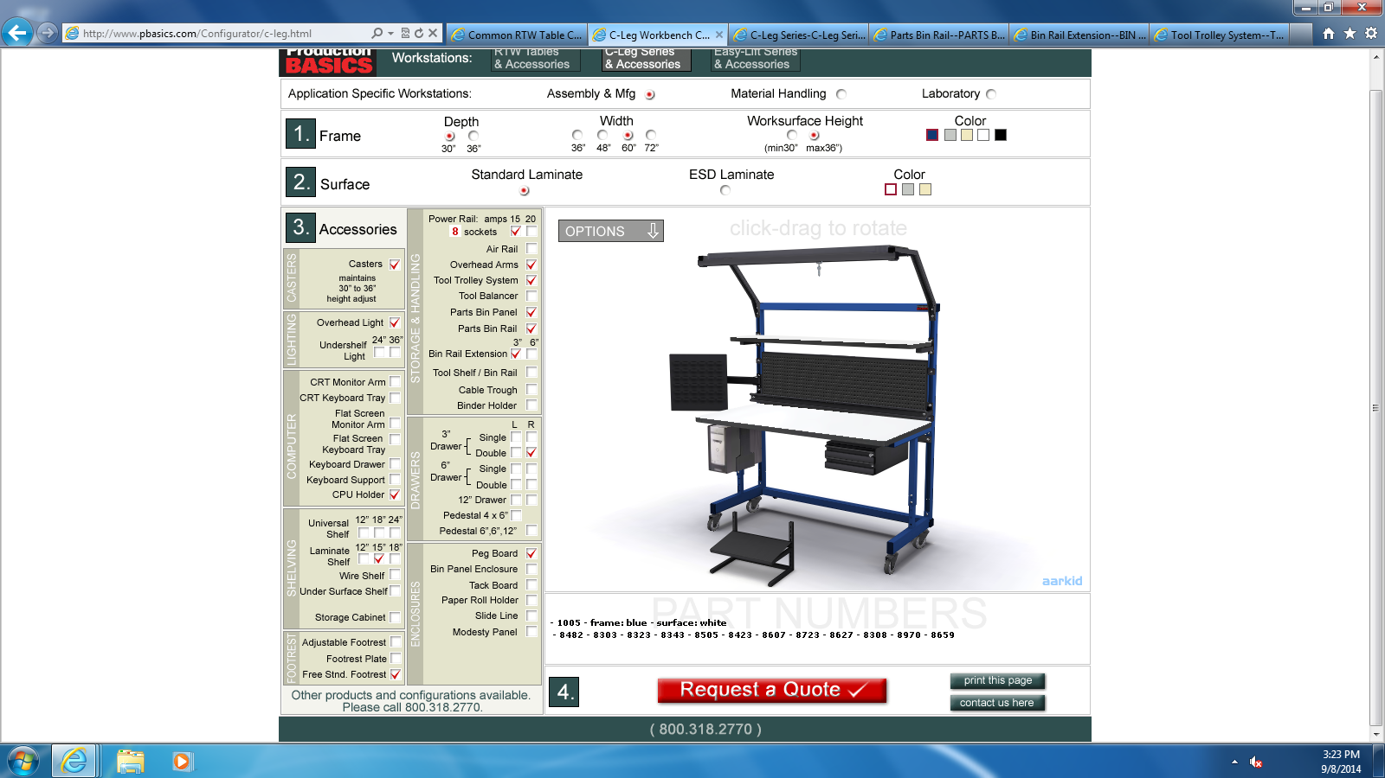
Competitive Products cont.
Figure 2:
IAC Industries
$1,283
Figure 1: Production Basics
Figure 3: LTW
$3,228
$4,446

Slide 6
Goals

Slide 7
Objectives
Design and create a workstation 64”H*43L”*27”W made of steel and wood.
Create database to store body measurements and input in Arduino program.
Increase productivity by 10-15% ($500k-750k opportunity with 5M in sales)
Reduce overall cost by eliminating health and safety issues such as Musculoskeletal disorder (MSD): $32,000.00.

Slide 8
Constraints (Design, Project & Customer)
Design Constraints
  Comply with 5’s (reduce waste and optimize productivity)
    Sort, Set in order, Shine, Standardize, Sustain
  Flexible for operators
  Safety!
Project Constraints
  3 Months for Design Development
  9 Months for Completion
  300 USD
Customer Constraints
  Cost effective & Reliable

Slide 9
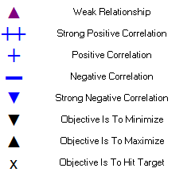
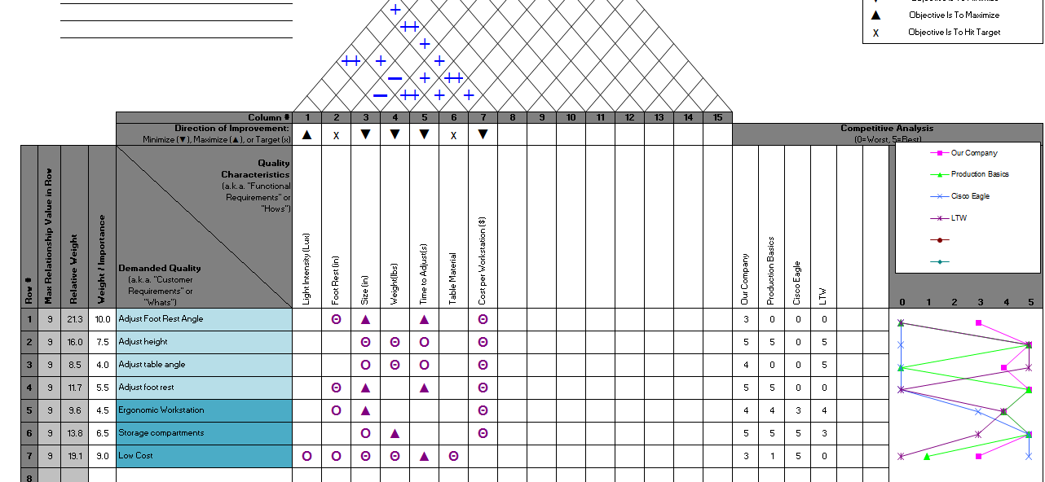
Quality Function Deployment

Slide 10
Competitive Products
 | Our Company | Production Basics
Feature 1 | Adjust height & angle electrically | Electric Height
Feature 2 | 500 Lummens (adjustable) | Not adjustable
Feature 3 | 12’’x7’’ foot rest | Foot Rest
Feature 4 | 65’’x43’’x27’’ | 36’’X48’’
Feature 5 | 200 lbs lift capacity | 125 lbs
Feature 6 | 15 s displacement | N/A
Feature 7 | HD Steel | Aluminum Legs
Cost | $3,500 (Target) | $3,228
Market Opportunity: $25,000,000

Slide 11
Functional Decomposition

Slide 12
Selection Process
How did you identify key components?
Competitive products? Brain Storming? Combination?

Slide 13
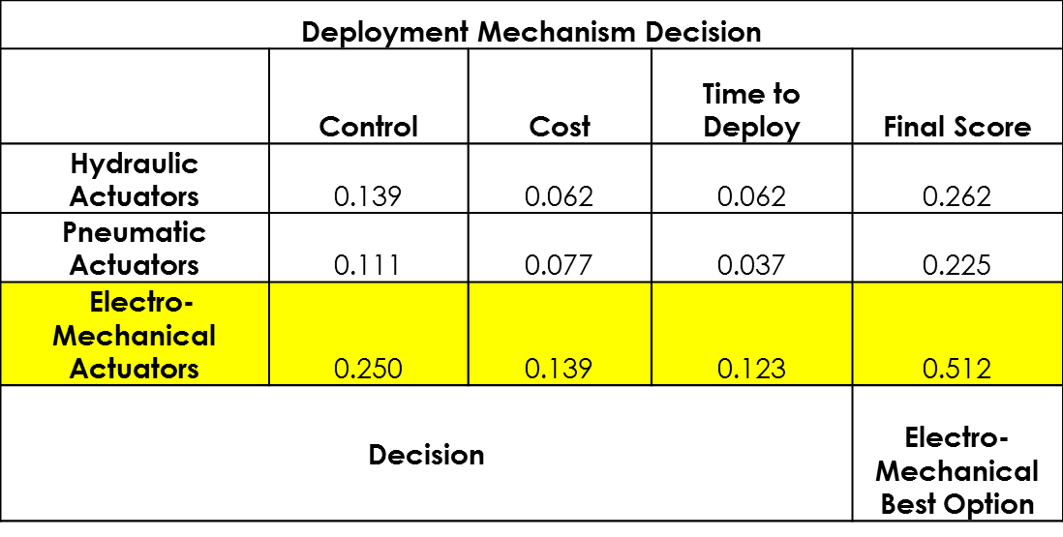
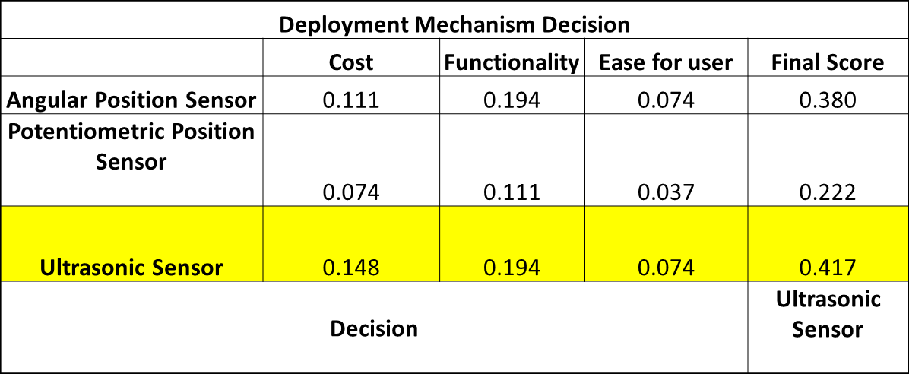
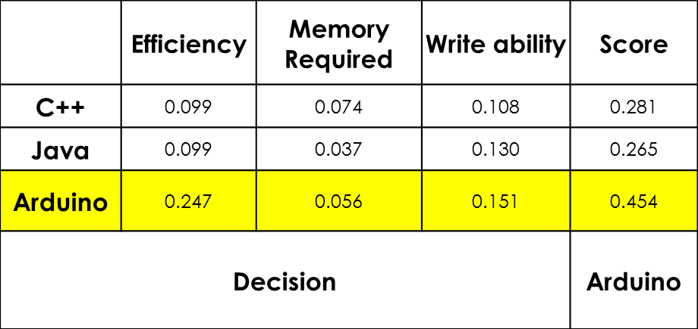
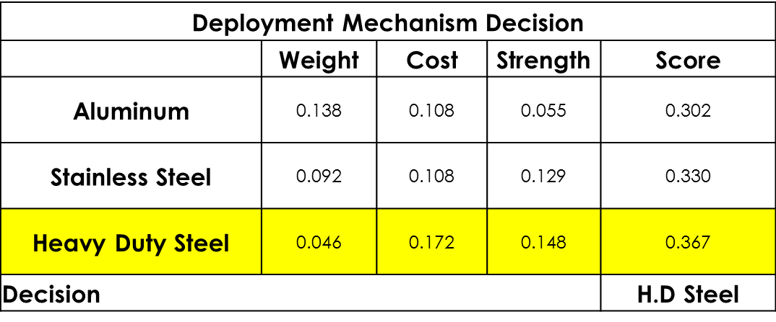
Concept Generation Results

Slide 14
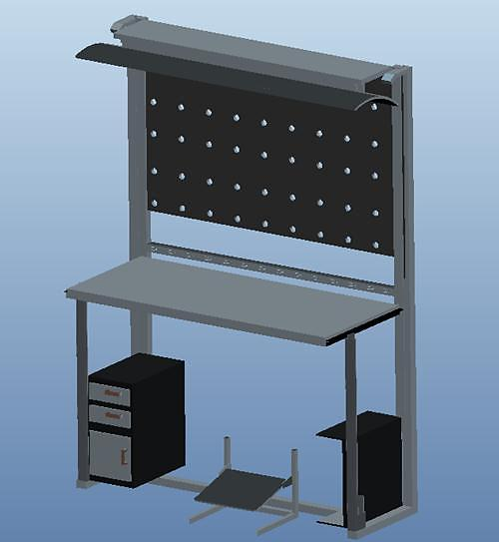
Final Design
Light Fixture
Cork sheet
Wooden Table Top
Actuators
Wooden Foot Rest

Slide 15
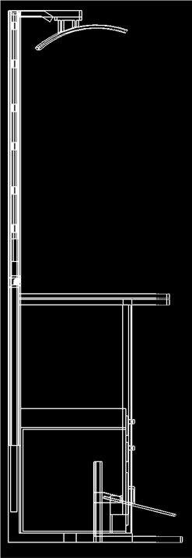
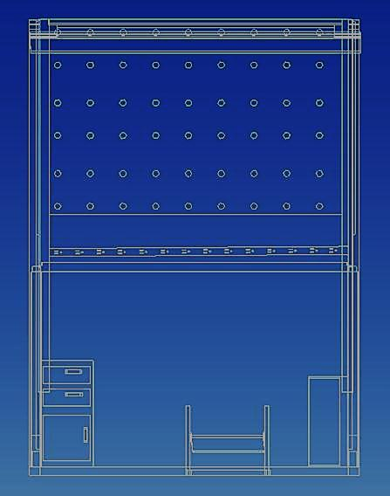
Drawings
65 in
27 in
43 in

Slide 16
BOM/Budget

Slide 17
Prototype Vs. Production Cost
Cost of Materials: | Material | Quantiy | Price | Total
 | Square Tubing 2'' (40 ft.) | 2 | 68 | 136
 | Hardwood (worktable) 1ft^2 | 9 | 2.5 | 22.5
 | Actuators | 4 | 50 | 200
 | Arduino Board | 1 | 13.8 | 13.8
 | Cork Sheet for Back | 1 | 60 | 60
 | Ultrasonic Sensors | 5 | 8.99 | 8.99
 | LED Fixture | 1 | 70 | 70
 | Arduino Cables | 40 | 3.89 | 3.89
 | Arduino Dsiplay | 1 | 21.88 | 21.88
 | Relay Board | 1 | 6.25 | 6.25
 | Light Sensor | 1 | 5.55 | 5.55
 |  |  | Total: | 548.86
Cost of Materials: | Material | Quantity | Price | Total
 | Square Tubing 2'' (40 ft.) | 2 | 55 | 110
 | Hardwood (worktable) 1ft^2 | 9 | 2 | 18
 | Actuators | 4 | 40 | 160
 | Arduino Board | 1 | 10 | 10
 | Cork Sheet for Back | 1 | 55 | 55
 | Ultrasonic Sensors | 5 | 5 | 25
 | LED Fixture | 1 | 55 | 55
 | Arduino Cables | 40 | 2.5 | 2.5
 | Arduino Dsiplay | 1 | 15 | 15
 | Relay Board | 1 | 4 | 4
 | Light Sensor | 1 | 3.5 | 3.5
 |  |  | Total: | 458

Slide 18
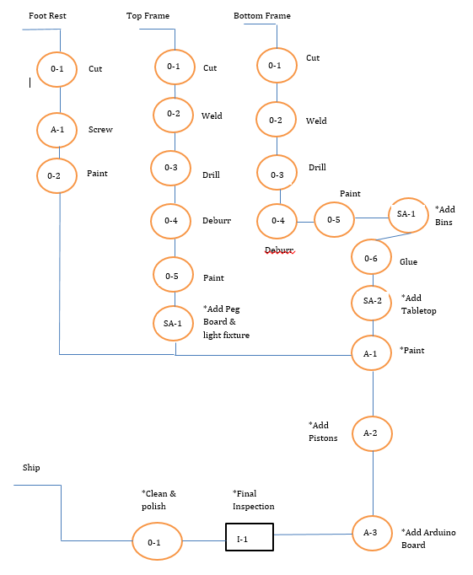
Assembly

Slide 19
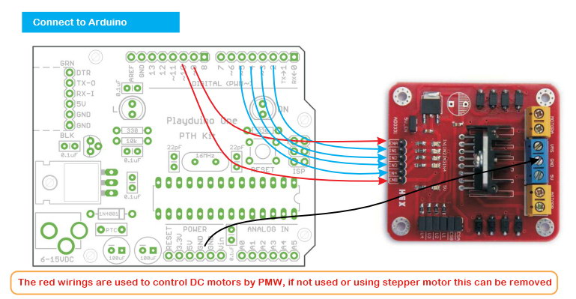
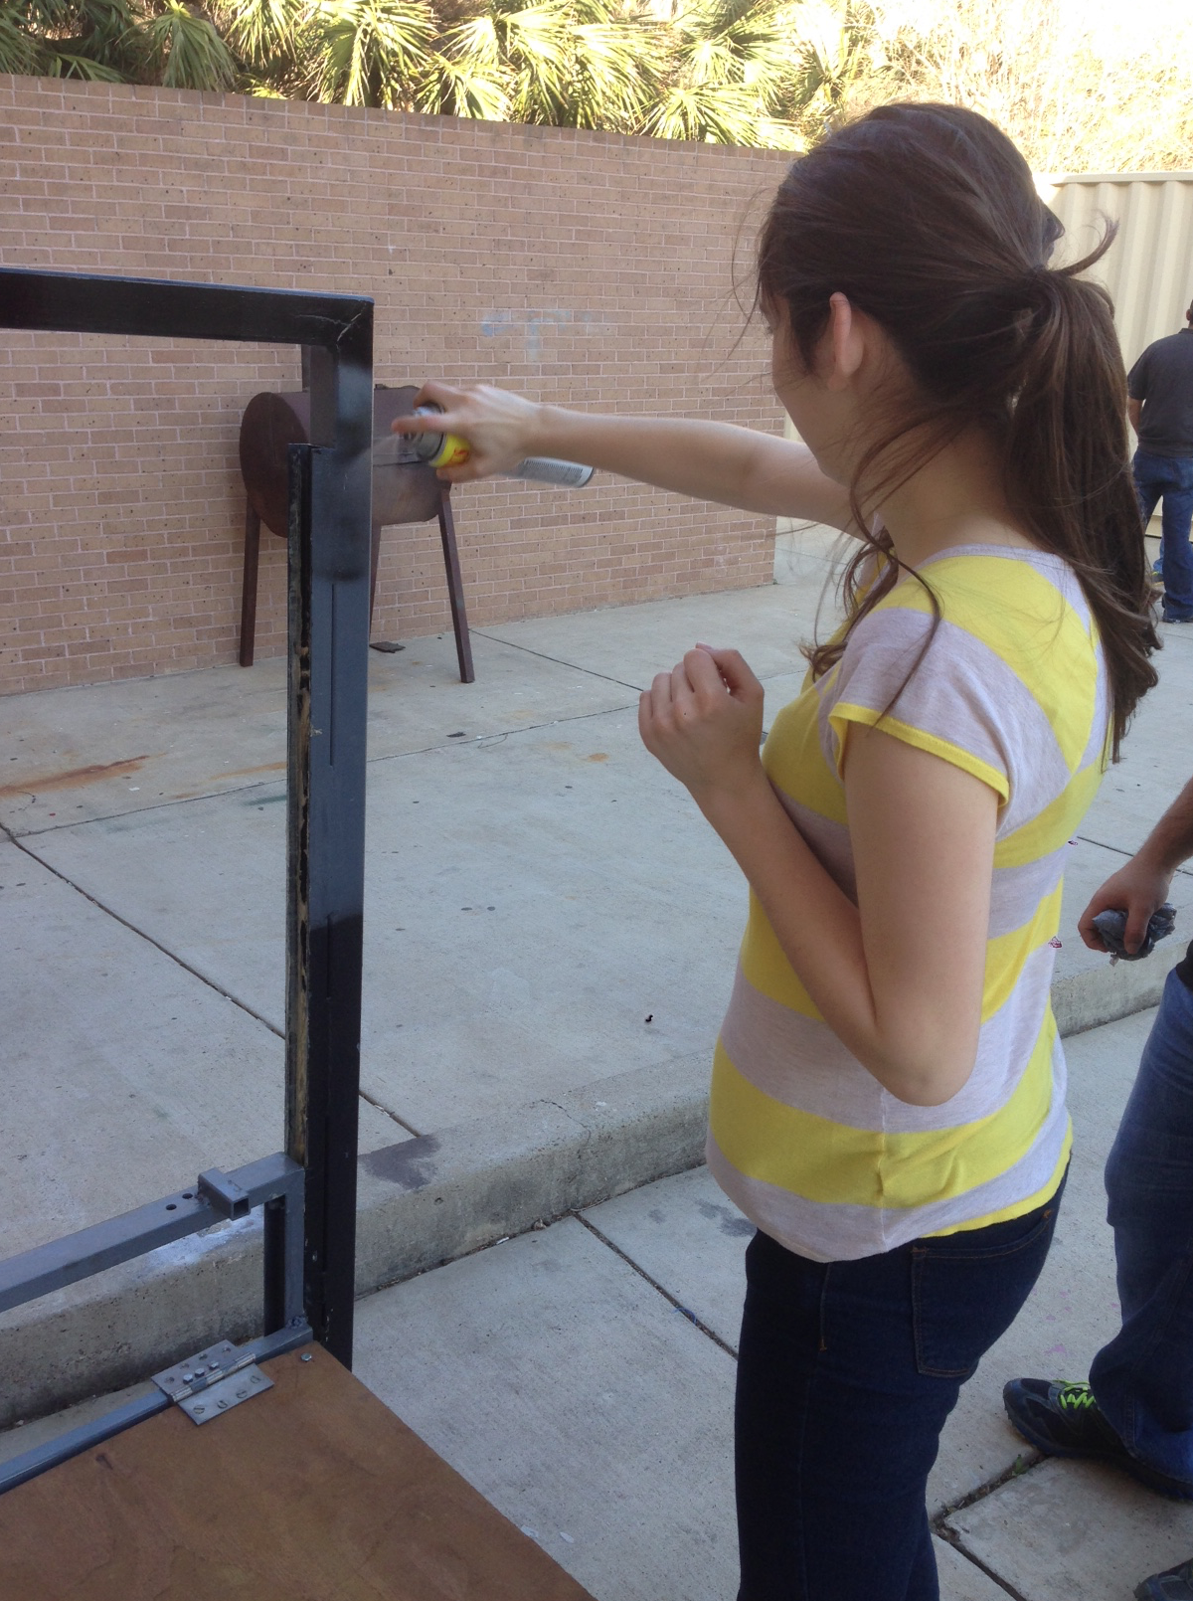
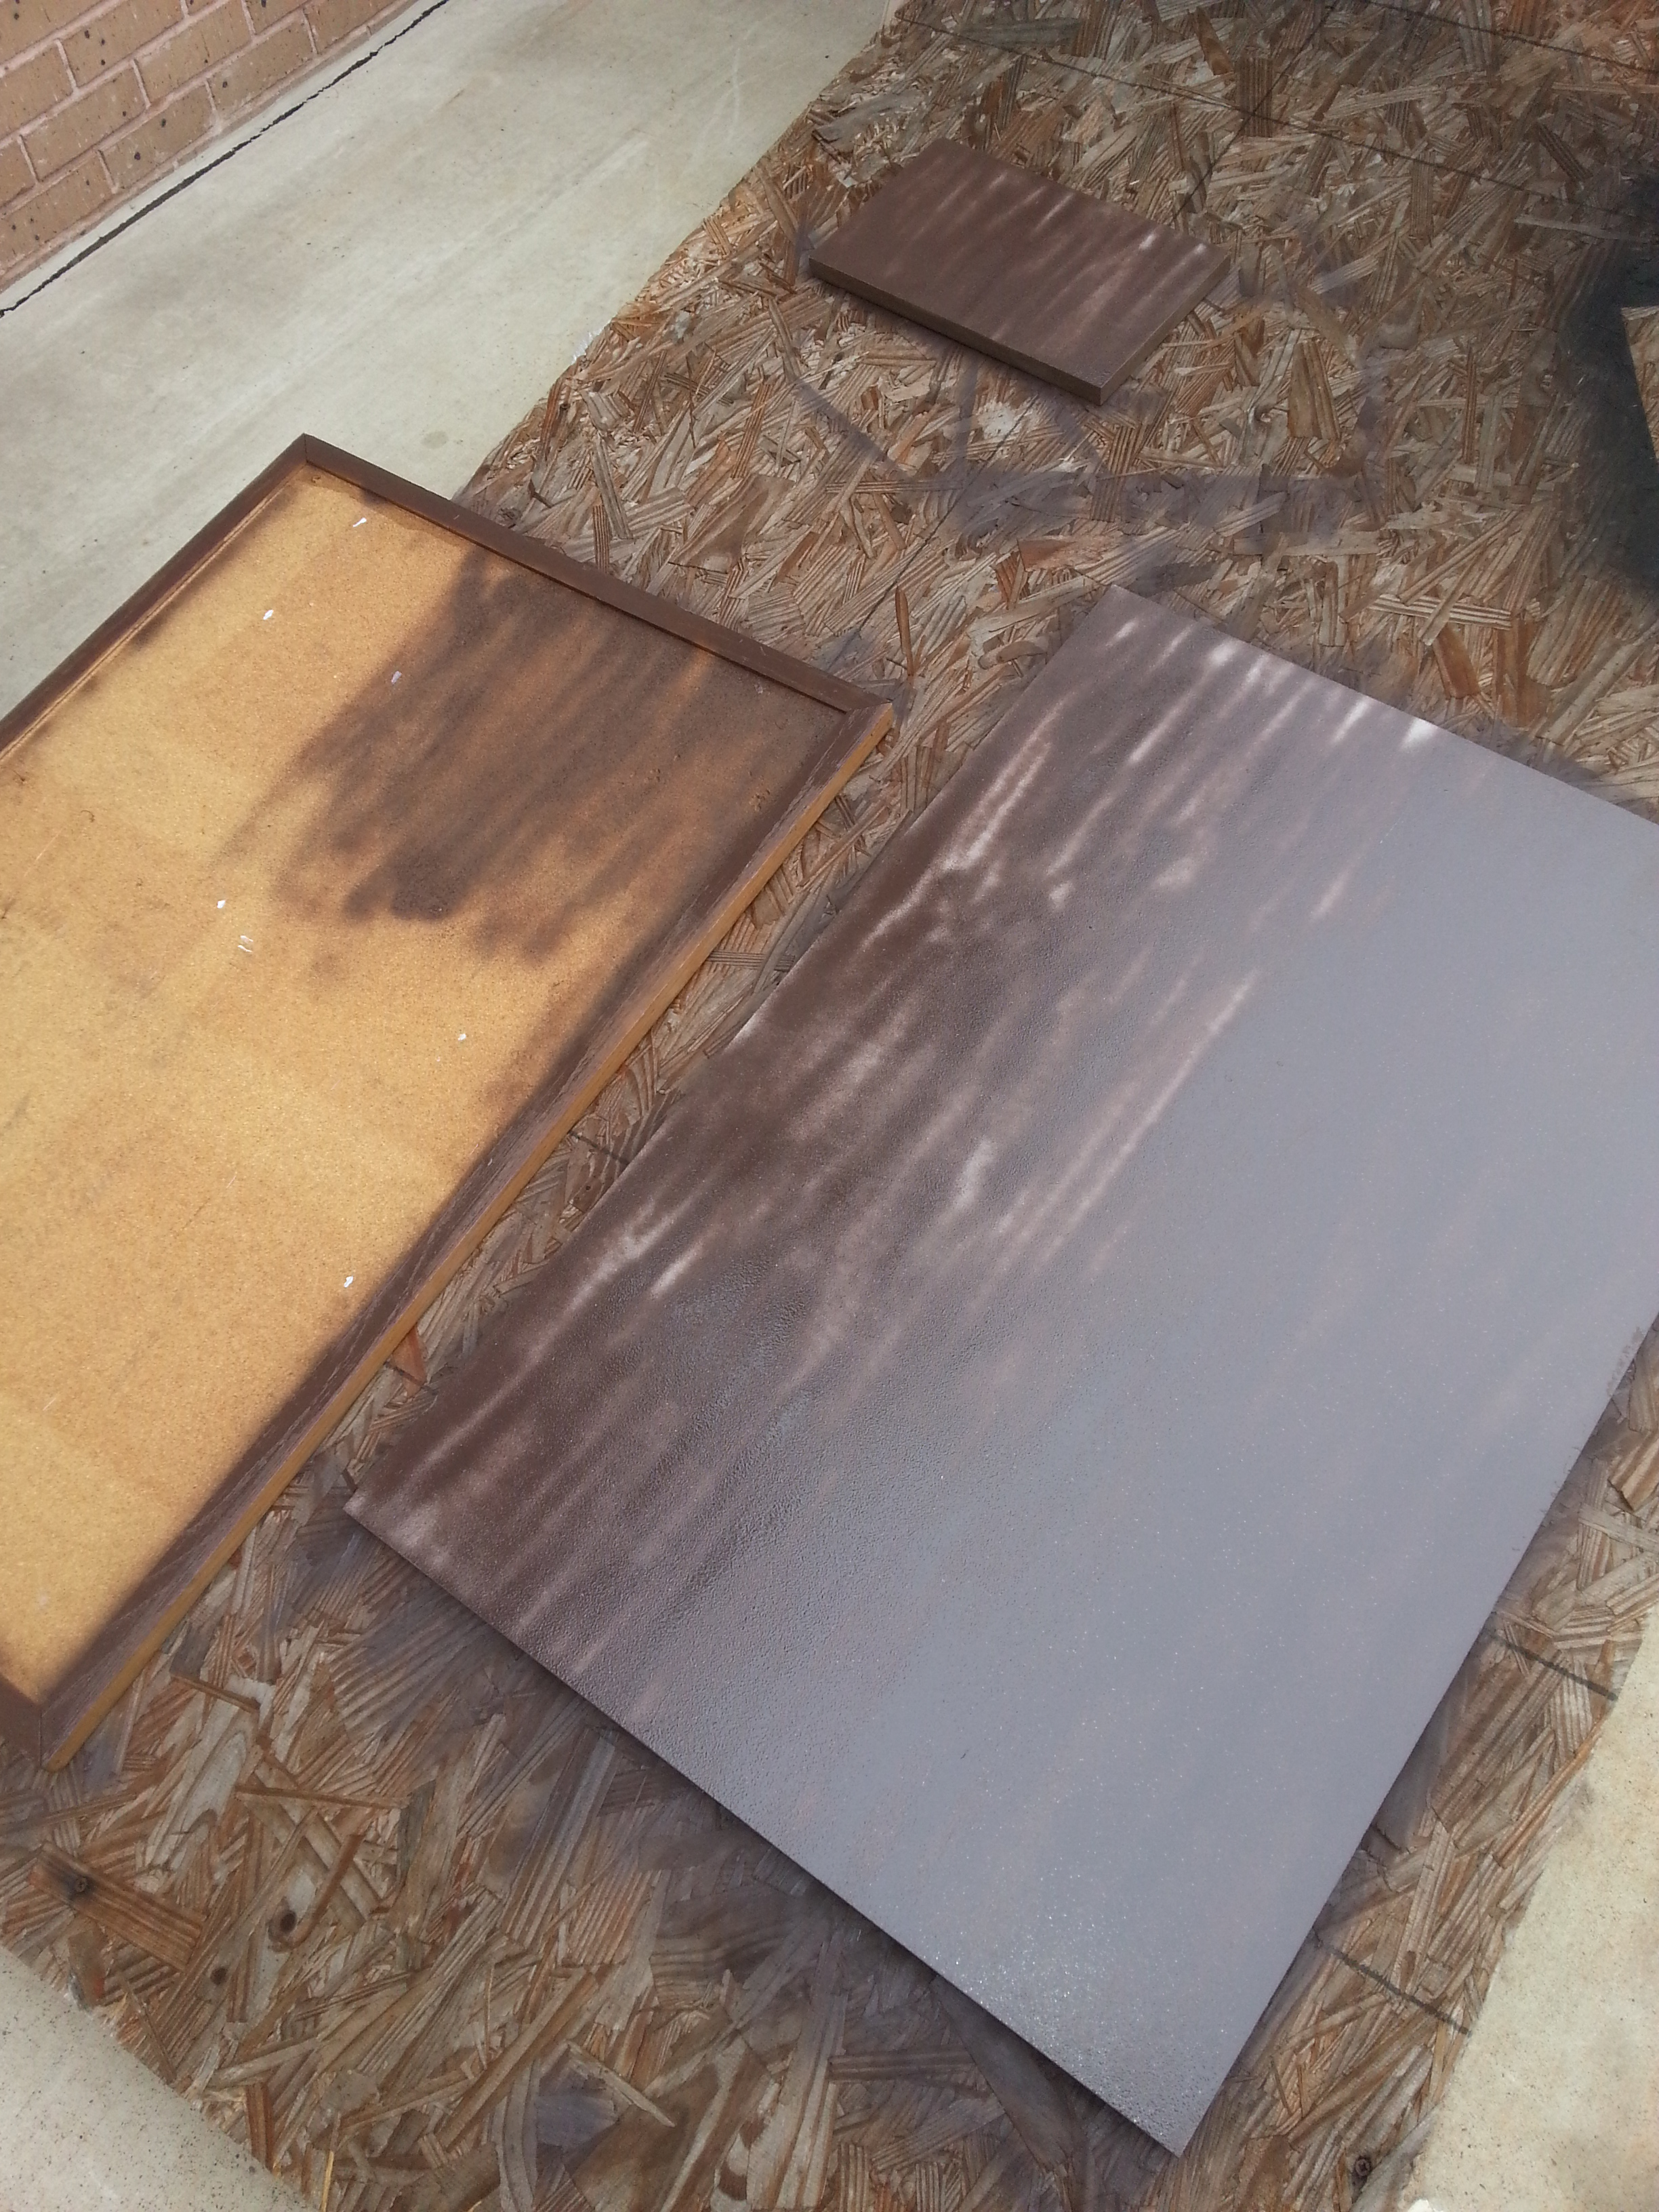
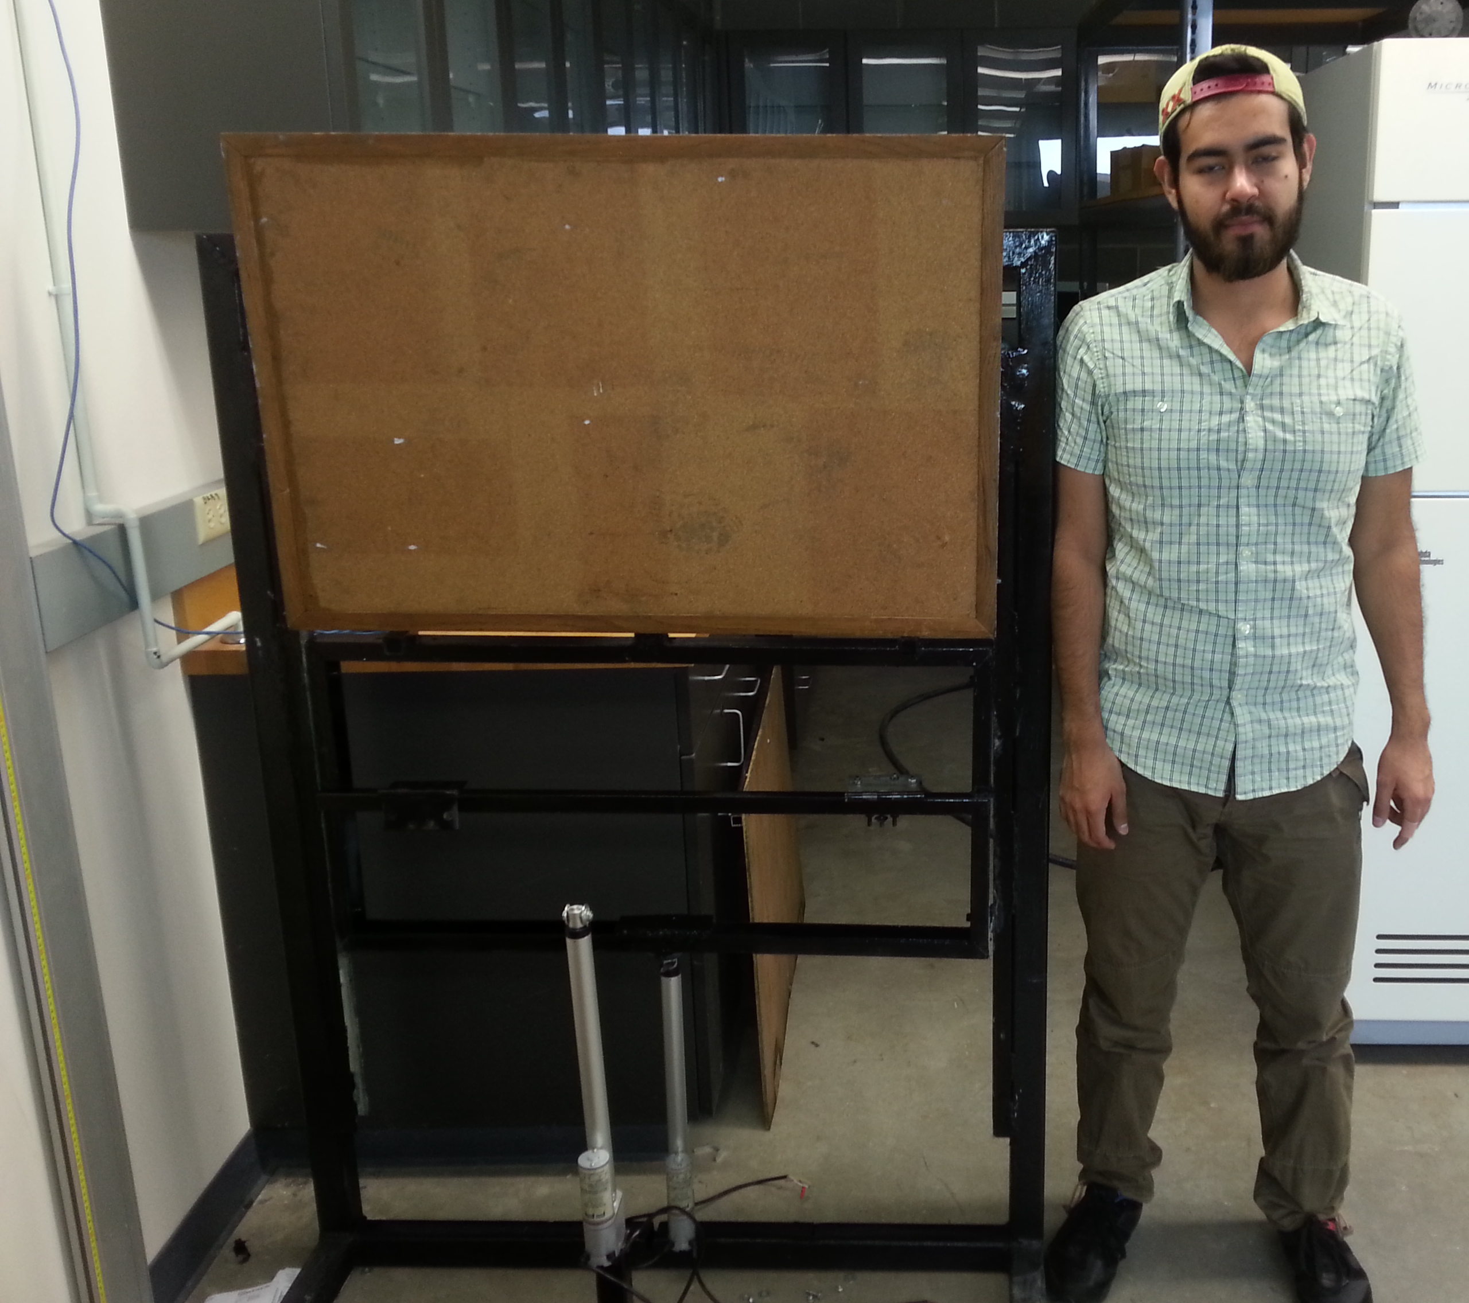
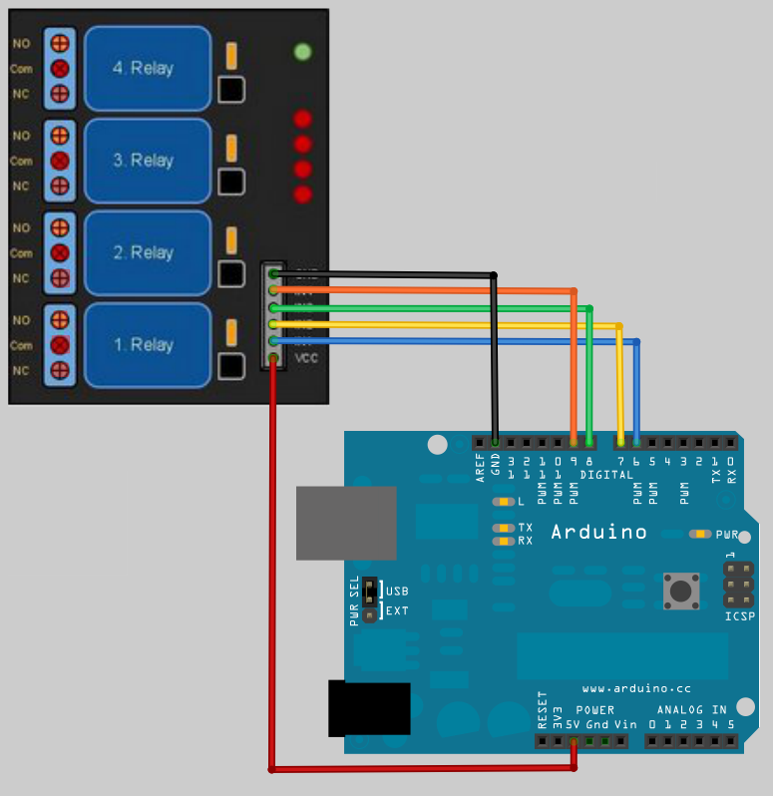
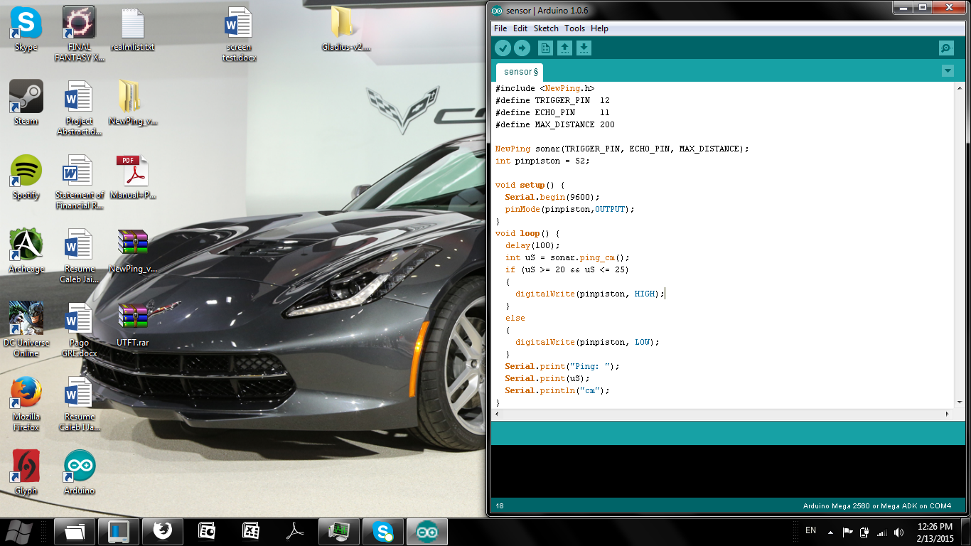
Prototype Building
Arduino Board
H-Bridge
Connections for:
Ground
5V
12V
Cables indicate where to connect from the Arduino board to the H-Bridge
Figure 1 Painting of Workstation
Figure 2 Connection for H-Bridge
The numbers where the cables are connected in the board represent the pin output
Relay
Arduino Board
Figure 3 Size Relation
Figure 4 Connection for Relay
Figure 5 Code for Pistons

Slide 20
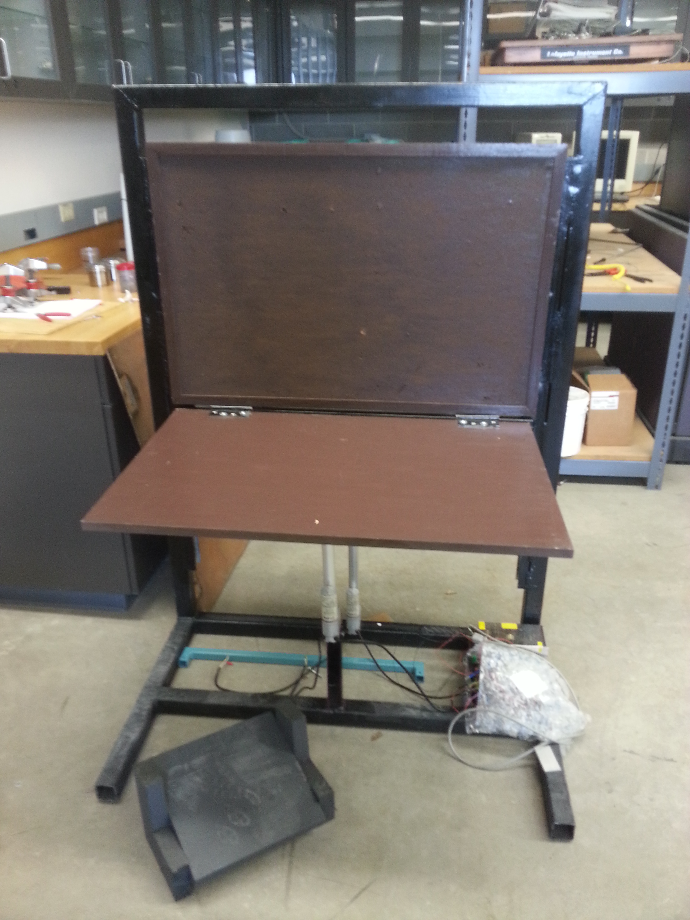
Final Design
Cork sheet
Light Fixture
Cork sheet
Wooden Table Top
Placement for Arduino
Actuators
Actuators
Wooden Foot Rest
Foot Rest

Slide 21
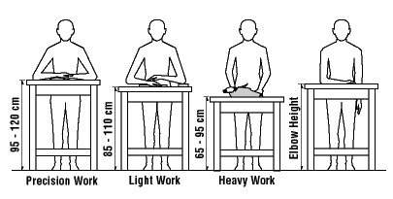
Ergonomic Measurements
National Institute of Occupational Safety and Health (NIOSH)
  Precision Work
    1-4in above elbow height
  Light Work
    Just below elbow height
  Heavy Work
    4-6in below elbow height
    Actual reference?

Slide 22
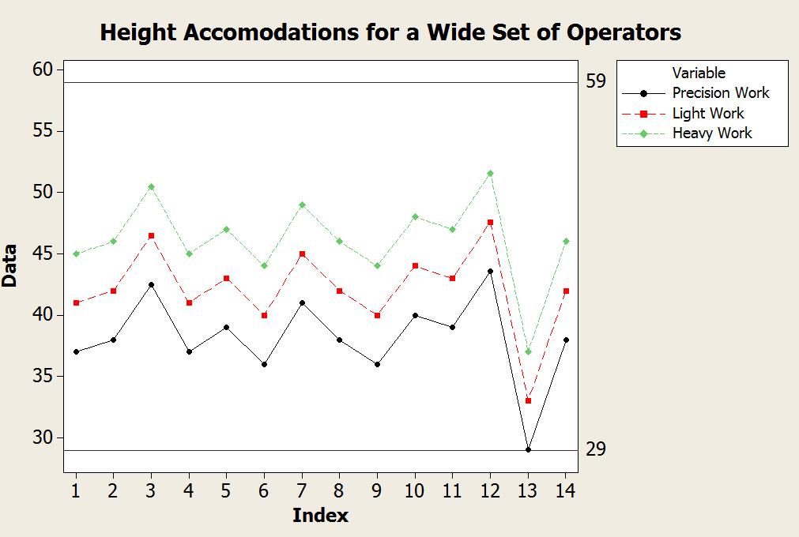
Data Collection
Height
#

Slide 23
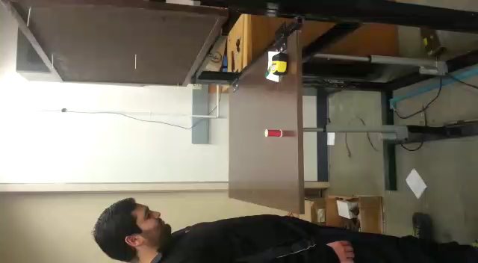
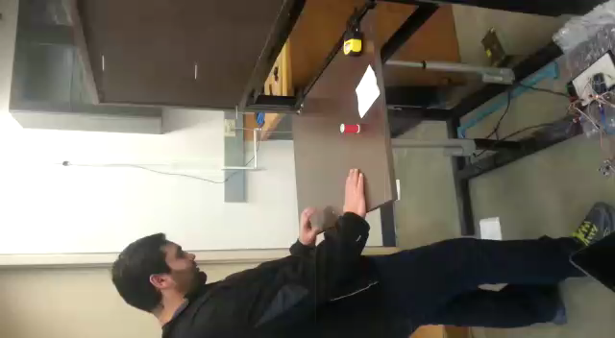
Test Trials - Precision
Ergonomically Correct
Ergonomically Incorrect

Slide 24
Operator #1-Precision Work

Slide 25
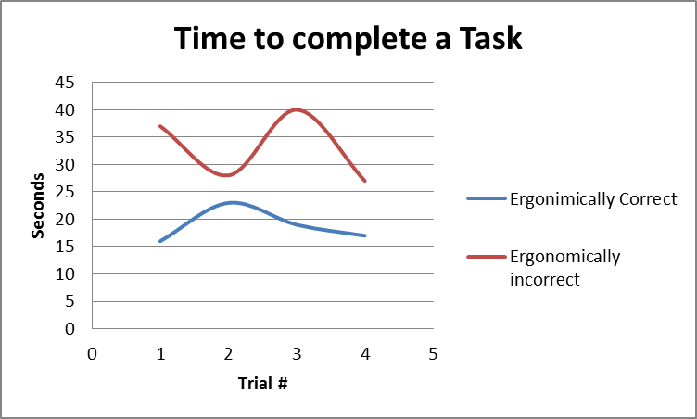
Operator #2-Precision Work
 | 11 Hr. Shift
 | Ergonomically Correct | Ergonomically Incorrect
Parts | 2112 | 1200
Parts Difference |  | 912
Lost production |  | 43%

Slide 26
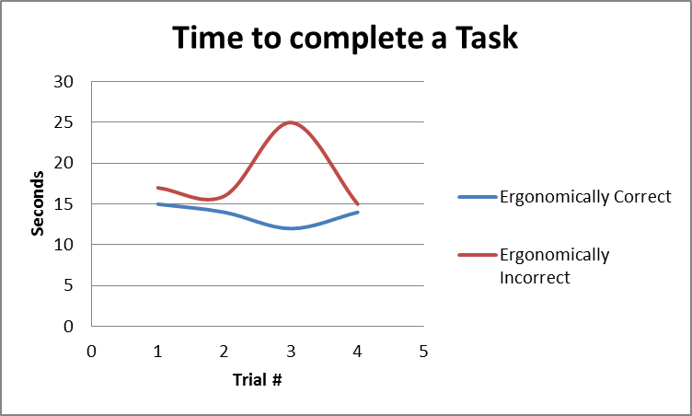
Operator #3-Precision Work
 | 11 Hr. Shift
 | Ergonomically Correct | Ergonomically Incorrect
Parts | 2880 | 2170
Parts Difference |  | 710
Lost production |  | 25%

Slide 27
Precision Task Average
 | Ergonomically Correct | Ergonomically Incorrect
Average (Time in Sec) | 16 | 24
 | 11 Hr. Shift
 | Ergonomically Correct | Ergonomically Incorrect
Parts | 2408 | 1642
Parts Difference |  | 766
Lost production |  | 32%

Slide 28
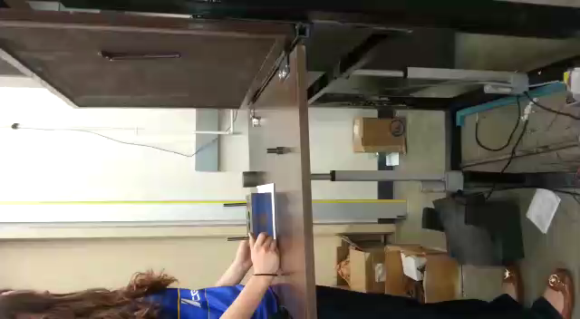
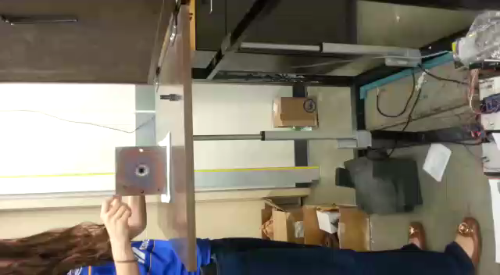
Test Trial 2- Heavy Work
Ergonomically Correct
Ergonomically Incorrect

Slide 29
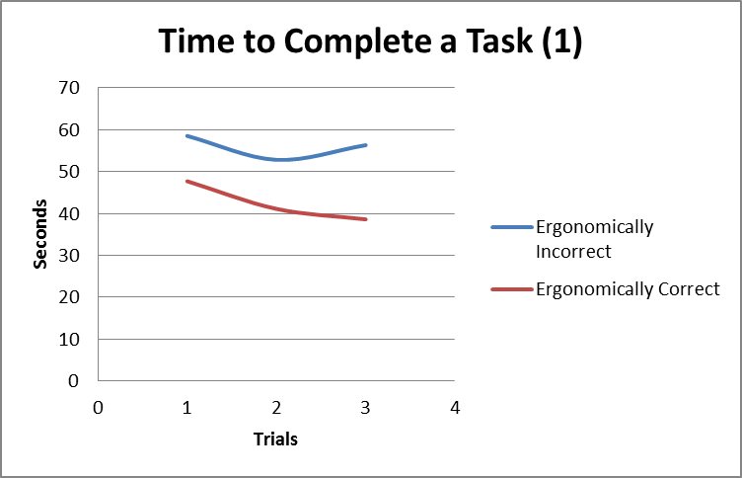
Operator #1- Heavy Work
 | 11 Hr. Shift
 | Ergonomically Incorrect | Ergonomically Correct
Parts | 709 | 932
Parts Difference | 224
Lost Production | 24%

Slide 30
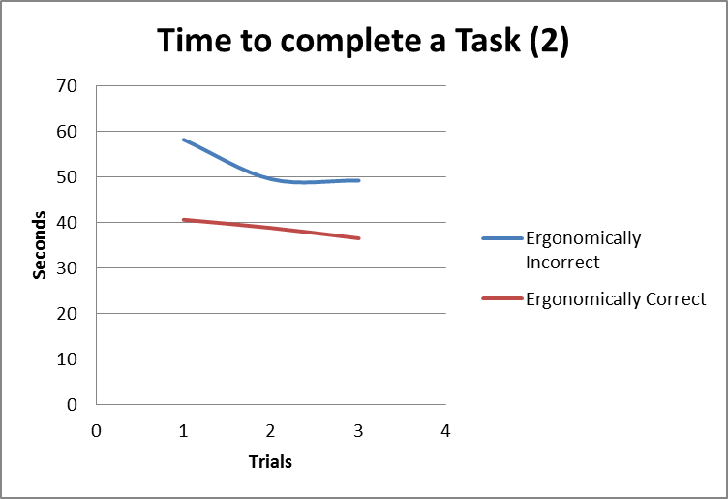
Operator #2- Heavy Work
 | 11 Hr. Shift
 | Ergonomically Incorrect | Ergonomically Correct
Parts | 757 | 1025
Parts Difference | 268
Lost Production | 26%

Slide 31
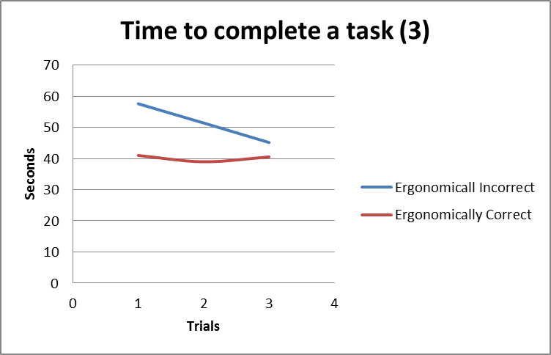
Operator #3- Heavy Work
 | 11 Hr. Shift
 | Ergonomically Incorrect | Ergonomically Correct
Parts | 771 | 986
Parts Difference | 215
Lost Production | 22%

Slide 32
Heavy Task Summary

Slide 33
Overall Results
Figure 1 shows overall results based on precision task
Figure 2 shows overall results based on precision task
Figure 3 shows time it takes for actuator to reach specified distance

Slide 34
ROI

Slide 35
Summary
Ergonomic workstation
  Increase productivity 10-15%
    Increase $500,000-750,000 gross profit
    Based on our studies 33% of loss in production!
  $25,000,000 Market Opportunity!
  Comply with 5’s
  Reliable, Capable, Profitable

Slide 36
Thank you

Slide 37
Operations Manual

Slide 38
Maintenance Manual

Slide 39
Gantt Chart

